Slide 1
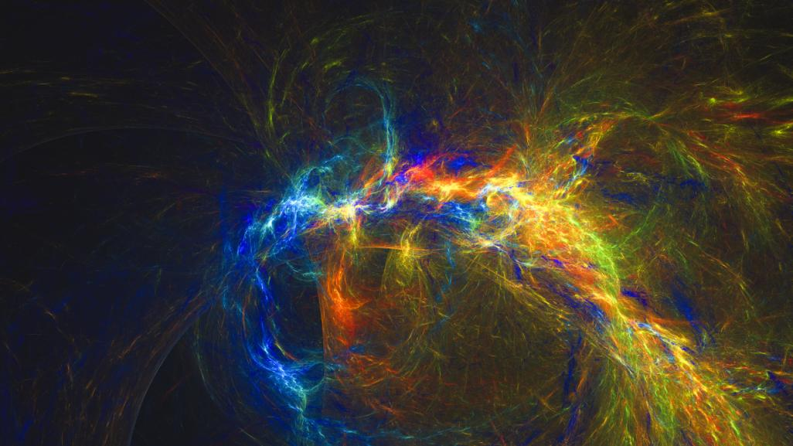
The fourth industrial revolution Kuala Lumpur, 2 March 2018 John Walter, ISO president

Slide 2
What is the Fourth Industrial Revolution?
Notes:
Many of us have different definitions of the Fourth Industrial Revolution.
But before we can understand the fourth, what about the other three?

Slide 3
The “other” Industrial Revolutions
Notes:
Before we can have an idea of the fourth industrial revolution, we need to have some idea of what industrial revolutions have come before us
Industrial revolution essentially means rapid development of industry, and there are several marked periods of history where this essentially ‘revolutionized’ the world.

Slide 4
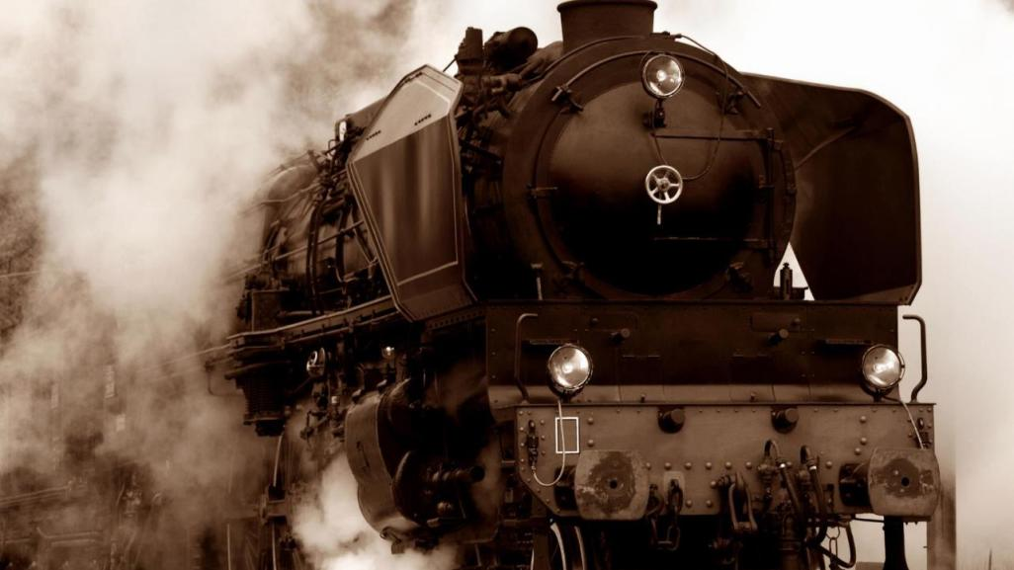
18thCentury
Steam power
Notes:
First industrial revolution: 18-19th centuries as steam power transformed production methods and thus initiated great social change.

Slide 5
19thCentury Mass production, new technologies
Notes:
2nd industrial revolution: 1870-1914 was a period of growth for many industries and the creation of new ones. It was an era of mass production, with technological advances such as the telephone, light bulb and the internal combustion engine.
3rd industrial revolution (1980s) equals the digital revolution: the advancement of technology from analog electronic and mechanical devices to the digital technology available today.
We’re currently in the Fourth, which builds on the third and represents new ways in which technology becomes embedded within societies and even our bodies. It includes robotics, artificial intelligence, the internet of things, 3d printing, autonomous printing, and many new and disruptive advances.
ISO is at the forefront of these areas – where standardization is hugely important.

Slide 6
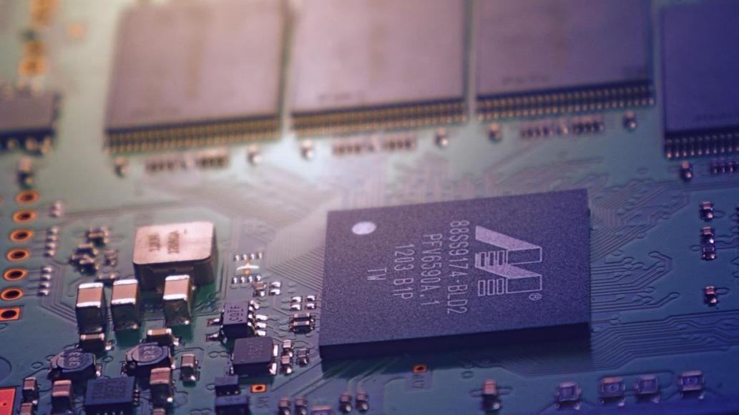
1980s
Digital revolution
Notes:
3rd industrial revolution (1980s) equals the digital revolution: the advancement of technology from analog electronic and mechanical devices to the digital technology available today.

Slide 7
Blurring the lines between the physical, digital and biological worlds
Notes:
We’re currently in the Fourth, which builds on the third and represents new ways in which technology becomes embedded within societies and even our bodies. It includes robotics, artificial intelligence, the internet of things, 3d printing, autonomous printing, and many new and disruptive advances.
ISO is at the forefront of these areas – where standardization is hugely important.

Slide 8
The role of standards in industrial revolutions
Notes:
Standards have been the building blocks of all these revolutions, and continue to be so
Just as standards were critical during the first industrial revolution, over 250 years ago, they’re taking a leading role in the fourth.

Slide 9
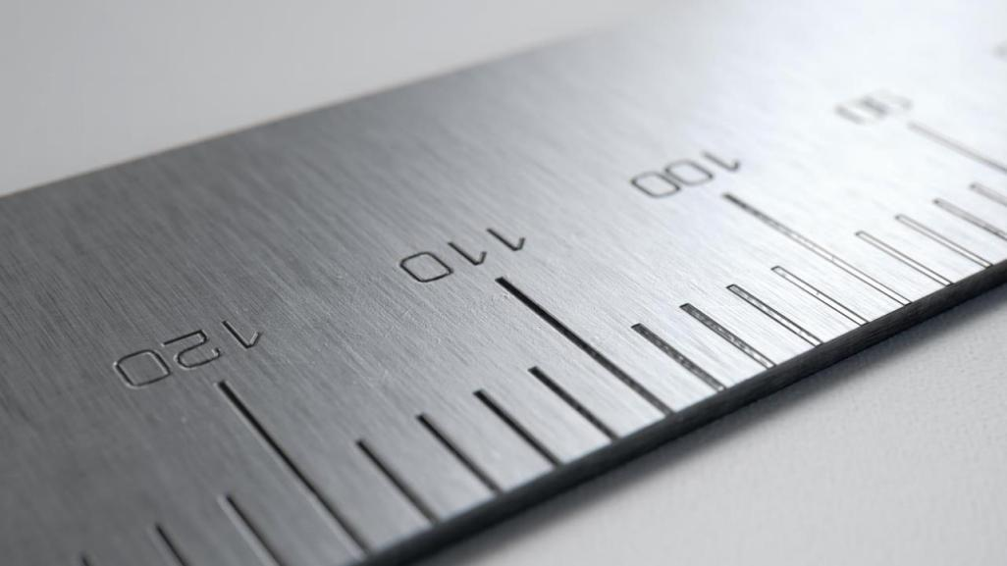
The universal language on which technology can thrive
Notes:
They provide a universal language
An early example of this is the birth of the metric system during the French Revolution – a uniform system for measurements that was agreed across countries (previously, many countries and even cities, had their own system for measuring things)
In the 18th C, a key driver of the industrial revolution was the concept of production with interchangeable parts (ie manufacturing from moulds, rather than each piece made by hand) – this enabled the move from manual production to machine production, meaning mass production
Standards allow for that interchangeability, interoperability, compatibility

Slide 10
Screw threads and fasteners
Standardization the key
Notes:
A key example of this was threaded fasteners
At the end of the 18thC and beginning of 19th C it was clear that threaded fasteners made it easier to assemble products because they connect parts together, and made them more reliable
In addition, they can be disassembled, meaning worn parts can be replaced easily
For more production, there was a greater need for screw threads – meaning users needed more and more reliable methods to guage them, calculate their strength etc
But there was no thread standardization – making interchangeability problematic
First standard for screw threads in 1841 (not ISO)
Standards for railways another example, in order to facilitate transport of goods

Slide 11
Going digital
Standardization provides a platform for innovation
Notes:
These days standards are not just about parts for machinery
They also provide an international language and codes for industries like banking, IT, data exchange of all kinds
The universal language they provide enables innovation to thrive, by providing confidence in systems and processes, on which they can develop further

Slide 12
ISO snapshot
Notes:
Now where does ISO stand in all of this?

Slide 13
We are an independent, non-governmental organization
We are a global network of national standards bodies with one member per country
Our job is to make International Standards
We are coordinated by a Central Secretariat in Geneva, Switzerland
Notes:
ISO is the world’s largest developer of international standards
It was first established in 1947 and now has more than 22,000 international standards covering virtually every sector and business
We are a global network of national standards bodies – with one member per country. DSM for example is our member for Malaysia.

Slide 14
We are not for profit: selling our standards allows us to finance their development in a neutral environment, to maintain them and to make new ones
ISO provides a platform for developing practical tools through common understanding and cooperation with all stakeholders
Notes:
We have a unique model, that works due to the strong collaboration, cooperation and consensus on which it is based

Slide 15
161 members
22051 International Standards
296 technical committees
100 new standards each month
Notes:
Through our 162 members we bring together experts to share knowledge and develop voluntary, consensus-based, market relevant International Standards that support innovation and provide solutions to global challenges.
Today we have around 22000 standards covering almost every industry, from technology, to food safety, to agriculture and healthcare. ISO International Standards impact everyone, everywhere.
We have many standards that will support the fourth industrial revolution.

Slide 16
Smart manufacturing
Standards provide the common communication method
Devices can communicate regardless of the chip, operating system or manufacturer
Notes:
An example of this is in what is known as Smart manufacturing
Smart is the buzz word of our time – it speaks of communication between devices of all kinds
This is derived from the Internet of Things – it makes factories smarter, safer and more environmentally sustainable.
Improvements to production and cost reduction are projected to generate billions in revenue growth and productivity over next decade.
There is an ability to track objects, observe usage and consumer behaviour, etc.
Standards provide the common communication method, allowing brands and technologies to interact through the same communications protocols = interoperability.
ISO established a smart manufacturing coordinating committee to address gaps in standardization.
The group brings together more than 20 ISO committees working on facets of smart manufacturing including Robotics, Internet of Things, Security and resilience, and works very closely with the IEC Systems Evaluation Group (soon to evolve to IEC Systems Committee) on the same subject.

Slide 17
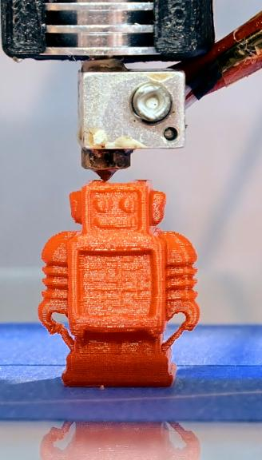
3d printing
Technology for the manufacture of prototypes, tools and industrial parts
Partnership with ASTM International
ISO/TC 261 Additive manufacturing: 7 standards + 14 in development
Notes:
Also known as additive manufacturing
It is a machine that enables the layering of materials to make parts or objects from 3D model data under computer control
It is an inherent part of the product development process used to manufacture prototypes, tools and industrial parts. It is a principle that can be applied to the creation of widely differing technologies.
ISO has a partnership with ASTM International (who also develops standards in this area) to ensure the most appropriate and effective standards are produced in this area that help to facilitate the development of the technology
ISO/TC 261 Additive manufacturing has developed 7 standards and has 14 more in development

Slide 18
Intelligent transport systems
Interoperability is the key to connected cars
Notes:
In the automotive industry, there are huge changes in navigation systems but also in technologies such as self driving cars.
Because better management of transport is necessary for a sustainable future.
ISO/TC 204 Intelligent transport systems, has nearly 250 standards in this field and another 100 in development.
These include those for self driving cars, as well as standards that support electric or hydrogen-powered cars, that help to make cities more sustainable through reduced energy use and pollution.

Slide 19
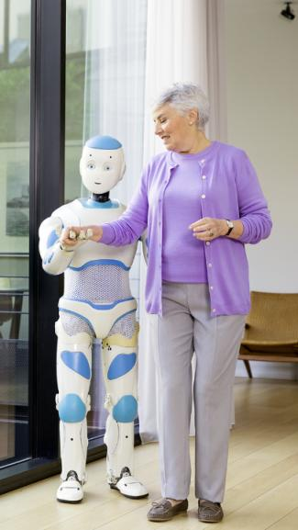
Personal robots
ISO 13482 – first international standard for personal care robots
Meeting safety requirements = exportability, market expansion
Notes:
As we contemplate the social change inherent in the Fourth Revolution, personal care robots are revolutionizing the way societies approach ageing and the too often disabilities that come with it.
ISO 13482 which defines the safety requirements for personal care robots.
Developers of these robots used the standard to guarantee and demonstrate internationally agreed safety levels, which allowed them to export their technology around the world.
Without such a standard, many industry players weren’t willing to invest in a product that might not be accepted because of safety concerns or unknown regulatory requirements.
Today we have a dedicated technical committee developing standards on robotics, providing greater certainty for the future.

Slide 20
Cyber security
ISO/IEC 27000 series the ‘cyber-risk toolbox’
Notes:
New technologies carry new risks – hacking, viruses, phishing, etc.
Cyber security and protection of intellectual property are key challenges in today’s digital era.
Once again, ISO is very active.
ISO/IEC 27001 series of standards is the world’s common language when it comes to assessing, treating and managing information-related risks.
A prime example is the cloud – where the marketplace is global and providers are dispersed across large geographical areas, crossing national boundaries. International guidance (standards) is key.
Standards for the cloud facilitate the development and expansion of secure cloud computing systems.
And also covers security of information sharing between different organizations.

Slide 21
Smart Cities and infrastructures
Collaboration and partnerships
World Smart City Forum events in Barcelona and Singapore jointly with IEC and ITU
#worldsmartcity
Notes:
City perspective – an application of the fourth industrial revolution to a city.
Between 60 % and 70 % of humanity is expected to be living in urban environments by 2050.
The future of cities affects everyone – everything from public transport, public facilities, water and energy supply. etc.
We all need to ensure that cities are prepared for the future.
Smart Cities requires a cross-functional approach. Cities are diverse ecosystems and also opportunities for innovation.
There’s a need to balance different stakeholder perspectives and expectations.
ISO standards already cover many areas that contribute to making a city ‘smart’ including:
Energy management systems, to reduce or improve energy use in organizations.
ISO 37101 is intended for use in sustainable communities.
ISO 39001 covers road traffic safety management systems, sustainable event management and intelligent transport.

Slide 22
ISO and the fourth industrial revolution
Ensure interoperability
Provide certainty in an uncertain environment
Notes:
As we have seen, the role of ISO standards is central to 4th industrial revolution.
One central aspect to all this is interoperability - and that is the core of standards. Devices need to be built using the same rules, using the same communication protocols, and exchanging data in compatible formats for all this to work.
Standards play a key role as a platform for new innovation and provide a common global language that facilitates interoperability.

Slide 23
Thank you
Notes:
Wrap up: these are just some examples
The Fourth Industrial Revolution has begun, but in order to seize its full potential for the betterment of society, standards are needed.

